Slide 1
Ship Arrest Effectively Managing Crew & Maintenance Requirements
- Lloyds Maritime Academy - London | December 2, 2011 | G. Robert Toney
Notes:
Move logo to bottom rh corner

Slide 2
Introduction
National Maritime Services is a global leader in the management of custody assignments for arrested and seized vessels. The company possesses significant experience in the foreclosure, arrest , attachment and ultimate liquidation of commercial ships and pleasure yachts in a multitude of jurisdictions. This service enables lenders and other claimants to maximize their financial return when vessel arrest becomes necessary. The company’s affiliate, National Liquidators, is the largest pleasure boat recovery and remarketing provider in the world.
Combined, the enterprise processes approximately 2,000 assignments annually.

Slide 3
Preliminary Arrest Evaluation
Cost vs. return
Amount of mortgage/claim
Vessel condition & value
Resource requirements
Other known or potential claims
Jurisdiction/location of vessel
Owner’s likely action/inaction
Arrest alternatives
Self-help recovery
Relocate to preferred jurisdiction
Requires consent of authorities/crew
Loan note enforcement
Attach alternate assets
Involuntary bankruptcy

Slide 4
Custody Assignment Goals
Ensure safety of vessel & crew
Enhance/preserve value
Control costs
Notes:
Bullet points, not checkmarks

Slide 5
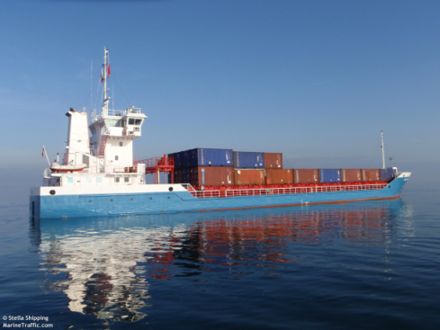
Arrest Services
Overall arrest planning
Watchman/keeper & security
Crew assessment & repatriation
Provisions, stores, bunkers & waste removal
Cargo & passenger discharge
Dockage/berthing & shifting
Interaction with authorities
Maintain classifications/certifications
Insurance

Slide 6
Crew Evaluation
Loyalty of master & crew
Immigration status
Ongoing medical issues
Pay/contract status
Security concerns
Identify non-essential crew

Slide 7
Insurance Issues
Prior/existing coverage
Status of existing premiums/calls
Affect of arrest/seizure
Name additional insured
Replacement coverage
Custodian’s liability
Port risk, P&I, pollution
Limited term

Slide 8
Cost Saving Opportunities
Reduce or eliminate existing crew
Utilize watchman in lieu of security service
Negotiate for required services
Move vessel to/from anchorage/berth
Adjust insurance coverage
Eliminate unnecessary services
Pendency of Arrest
C
o
s
t
Time

Slide 9
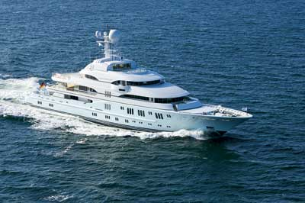
Yacht Foreclosure
No business value
Similar complexities to a commercial ship
Consider self-help vs. judicial foreclosure
Significant storage, maintenance & crew
Market evaluation
Sales strategy

Slide 10
Custody Case Examples

Slide 11
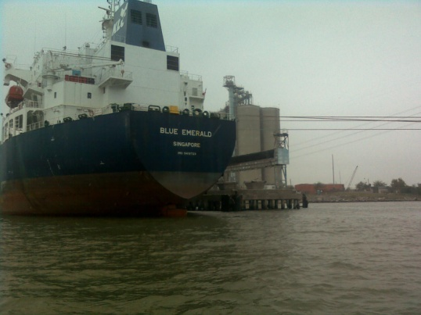
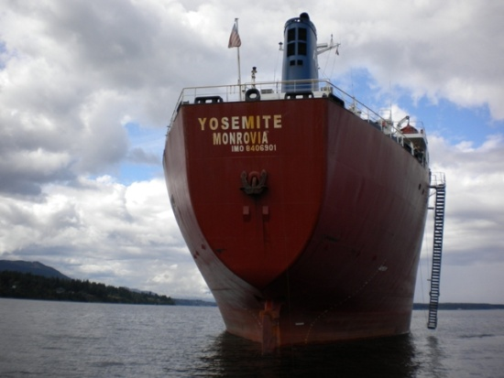
M/V Blue Emerald Arrest
51,332 dwt product tanker, 2009 build, Singapore registry
Ship mortgage foreclosure - Korea Line (Singapore)
Included in Chapter 15 filing
Reduced crew to minimum safe manning
Arranged short-term port risk insurance and P&I coverage
Negotiated less-expensive berth
Resolved complicated crew pay issues - diverse group of claimants
Managed crew injury claim – maintenance & cure
Assisted in vessel transfer to new buyer

Slide 12
M/V Yosemite Arrest
28,019 dwt bulk carrier, 1985 build, Liberian flag
Ship mortgage foreclosure relating to Eastwind bankruptcy
Vancouver, Canada location
Significant interaction with Canadian authorities and ITF
Replaced key officers and unnecessary crew
Maintained Nippon Kaiji Kyokei (“NK”) class certification
Utilized crew to make ship “sale ready”
Oversaw court sale, staffed auction

Slide 13
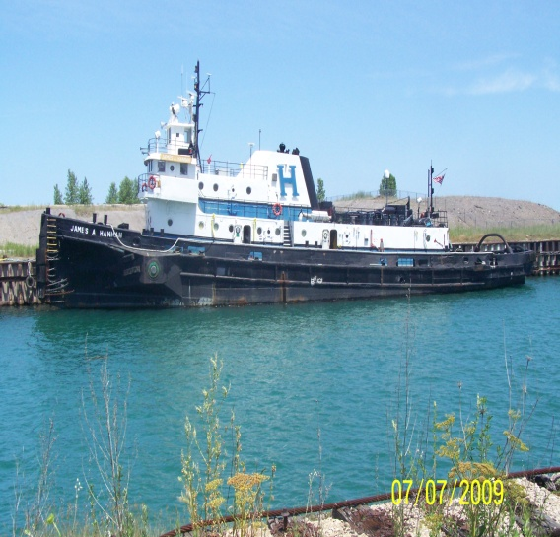
Hannah Marine Fleet
Fleet of 12 tugs & 9 barges
Retained by mortgagee bank
Collateral located in 4 various states
Cooperative owner surrendered vessels
Other liens required arrest and subsequent
marshal sale to cleanse title
National provided security, dockage,
maintenance and port risk cover

Slide 14
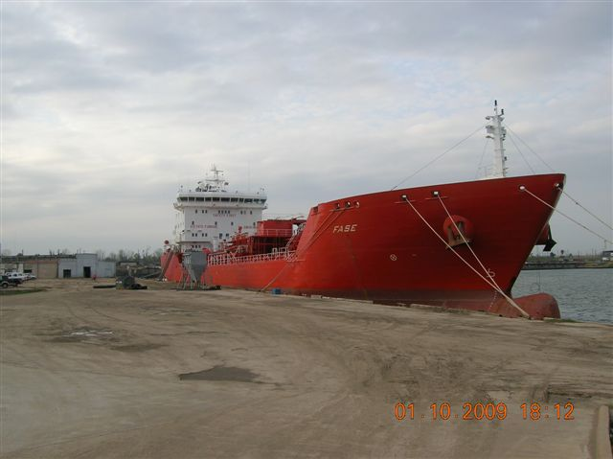
M/T Fase Arrest
16,750 dwt combined oil & chemical tanker, 2004 build, Liberia flag
Ship mortgage foreclosure
Required bio-diesel cargo offload/hired additional AMO crew
Completed life raft certification to enhance value
Sold $26+ million

Slide 15
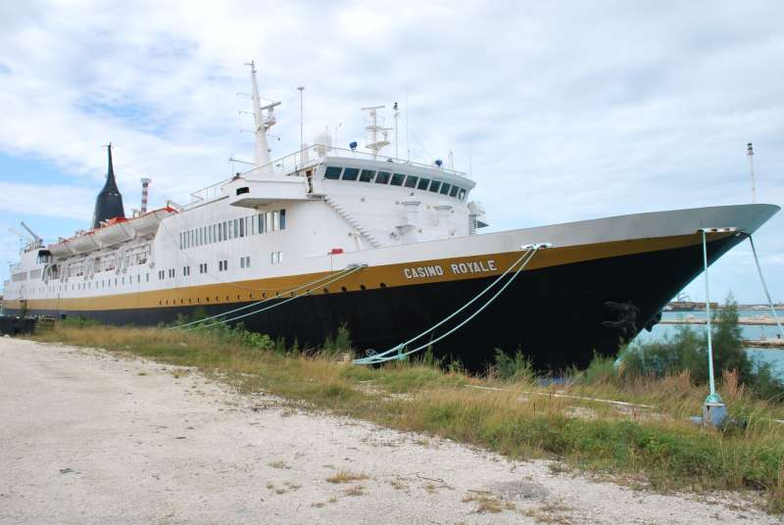
M/V Casino Royale Arrest
178 cabin gaming cruise ship, 1975 build, Bahamas flag
Located in Bahamas/retained by Bahamian Admiralty Marshal
Required significant interaction with Bahamian government
Alternative claims to gaming equipment
Repatriated unnecessary crew
Vessel ultimately sold as scrap

Slide 16
F/V Lady Elizabeth Recovery
35 meter commercial fishing vessel, 2000 build, US flag
Retained by mortgagee bank
Self-help recovery, Costa Rica
Negotiated release from other Costa Rican claimants
Relocated to favorable jurisdiction for judicial arrest & court sale

Slide 17
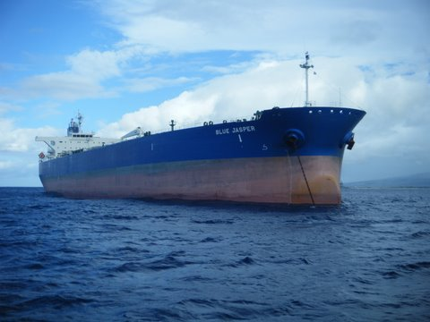
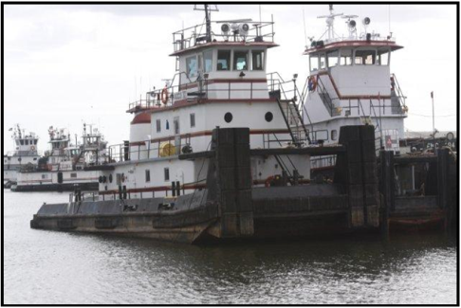
Representative Ship Sales
M/T Blue Jasper
105,905 dwt Aframax tanker
NMS court-appointed custodian
Collaborative sales effort with S&P broker
Hired by mortgagee to validate commercial
reasonableness of sale
$42.5 million sales price
Accumarine Assets
5 Inland push boats
8 Dbl skin tank barges
2 locations (AL & TX)
Sold at auction & post-sale
6 different buyers
$7 million+ cumulative price

